Slide 1

Comprehensive Analysis and Predictive Modeling of Global Development Trends
Name: Muhammad Faisal
Reg No: BSCS202110

Slide 2
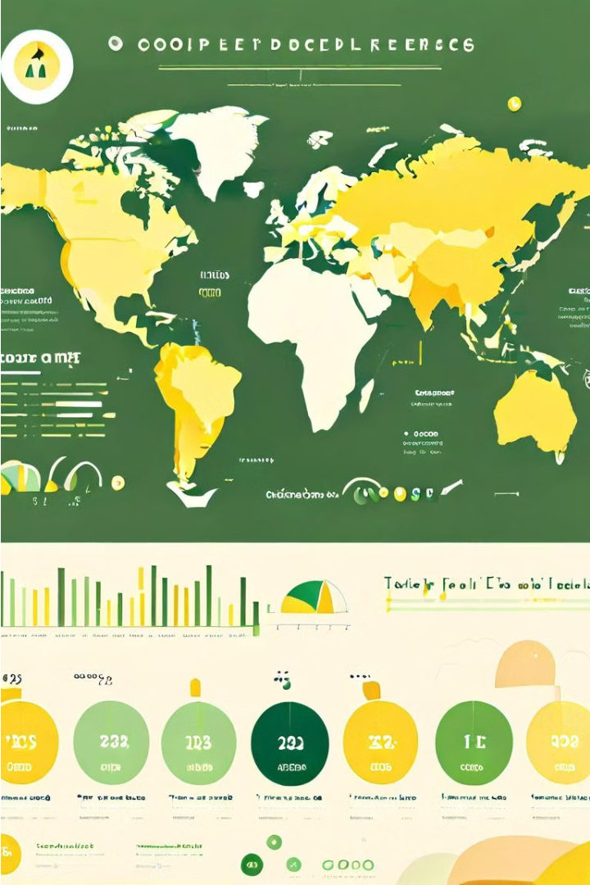
Introduction
Background: Overview of the World Bank Development Indicators (WDI) dataset.
Objectives:
Explore and identify patterns in the data.
Perform data preprocessing for quality enhancement.
Analyze correlations and inter-indicator relationships.
Conduct time series analysis for GDP forecasting.
Develop predictive models using regression, classification, and clustering.

Slide 3
Research Questions
1
How have global development indicators evolved over time?
2
Are there strong correlations between different indicators?
3
Can we predict a country's GDP using other indicators?
4
Can we classify countries based on their development indicators?

Slide 4
Related Work
Previous Research:
Economic Growth Analysis: Impact of trade, investment, and policies.
Environmental Sustainability: Trends in climate
change and energy consumption.
Social Development: Insights into education, health, and poverty.

Slide 5






Methodology
Data Collection
1
Aggregate global development indicators from the World Bank database
2
Data Preprocessing
Handle missing values, outliers, and data transformations
Exploratory Analysis
3
Conduct statistical analysis and visualizations to uncover patterns
Modeling
4
Apply machine learning techniques for predictive modeling
Evaluation
5
Assess model performance and interpret the results

Slide 6
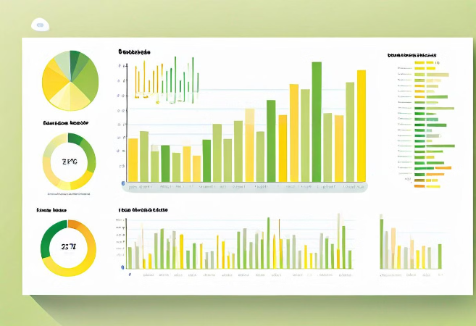
Exploratory Data Analysis (EDA)
Feature Engineering:
Data description and feature importance.
Visualizations:
Histograms for data distribution.
Scatter plots for feature relationships.

Slide 7
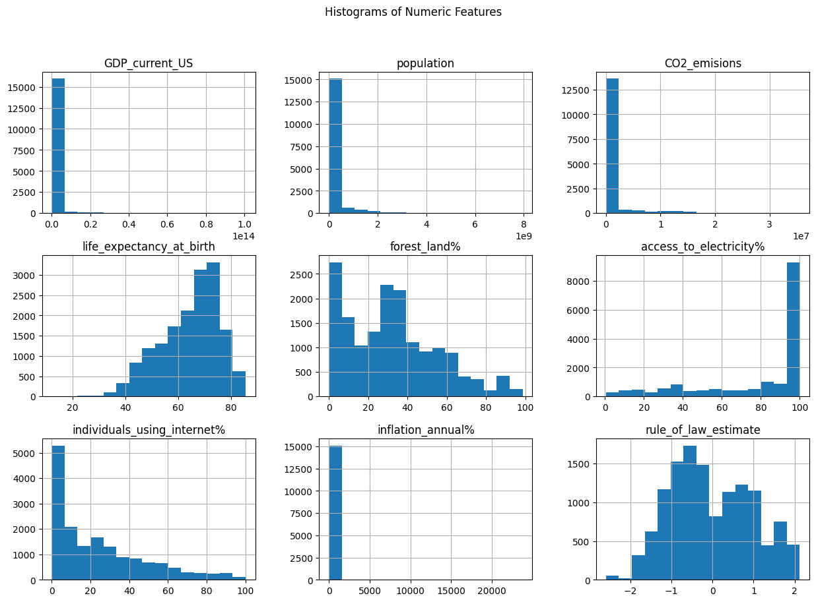

Slide 8
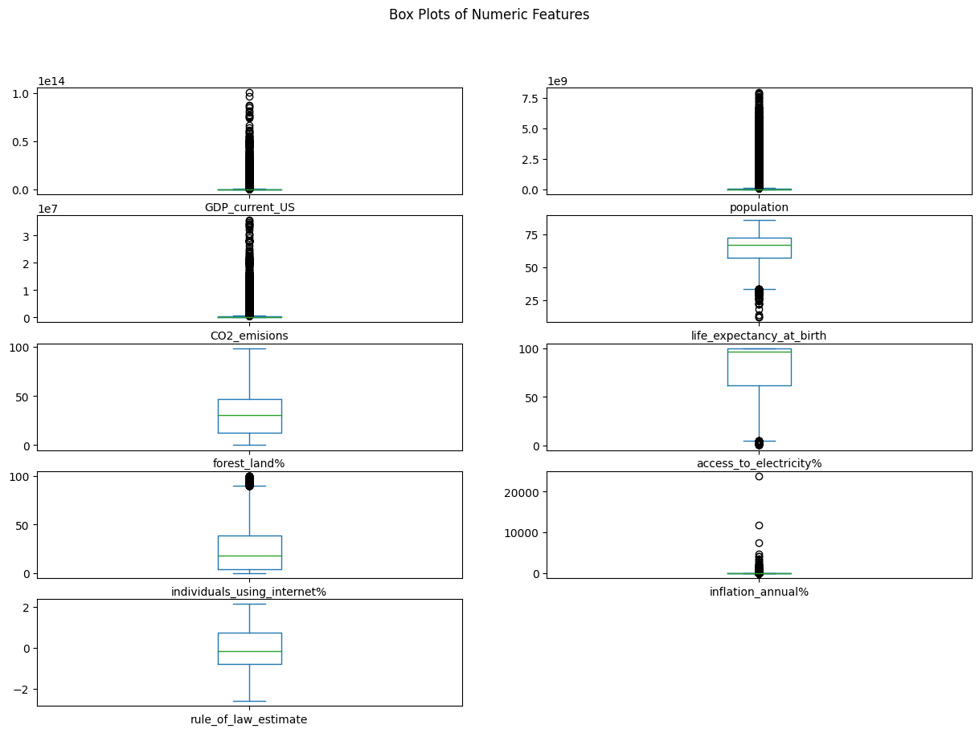

Slide 9
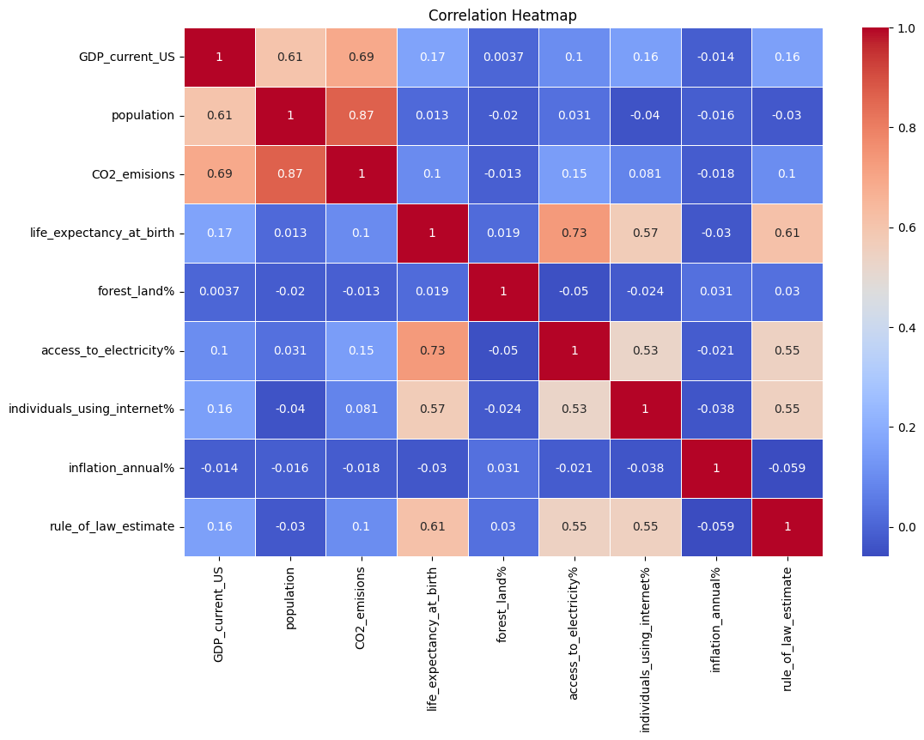

Slide 10

Data Preprocessing
1
Data Cleaning
Identifying and addressing missing values, outliers, and inconsistencies in the dataset to ensure data quality and integrity.
2
Feature Engineering
Creating new features from existing data to enhance the predictive power of the models and uncover hidden patterns.
3
Normalization and Scaling
Transforming the data to a common scale to prevent certain features from dominating the objective function during modeling.

Slide 11



Correlation Analysis & Time Series Analysis
Correlation Analysis
Time Series Analysis
Predictive Modeling
Examine the relationships between key development indicators to uncover insights into interdependent factors driving global progress.
Analyze historical trends and patterns to identify long-term drivers and forecast future development trajectories across regions and sectors.
Leverage advanced statistical techniques to build predictive models that can estimate the future evolution of global development metrics.

Slide 12
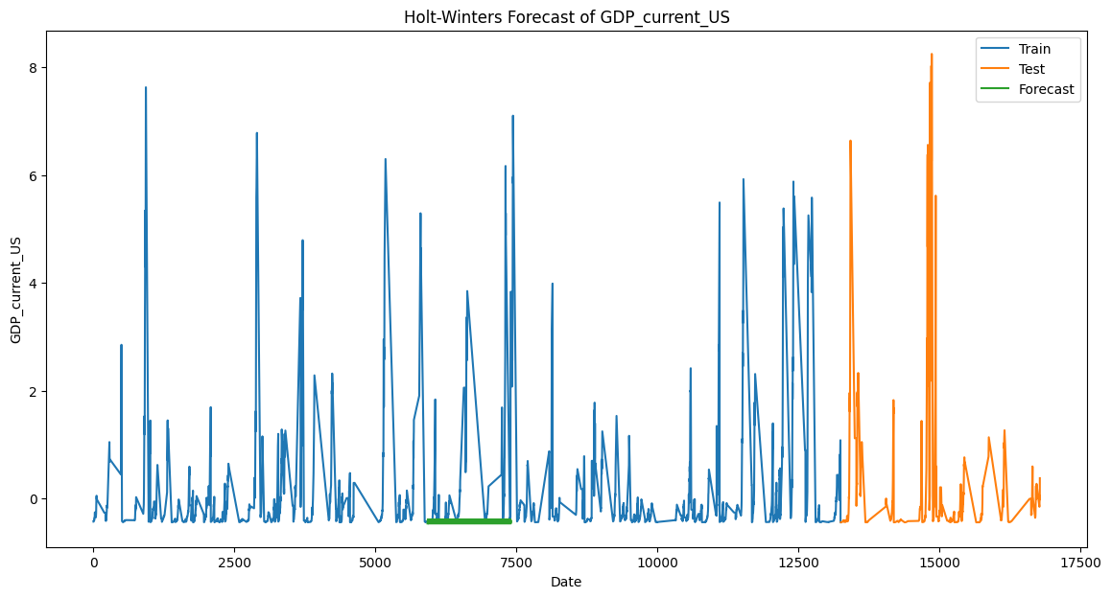

Slide 13
Modeling
Techniques Used:
Regression Analysis: Predicting continuous variables.
Classification Analysis: Predicting discrete categories.
Clustering Analysis: Identifying groups of similar data points.
Model Evaluation:
Metrics for regression, classification, and clustering.

Slide 14
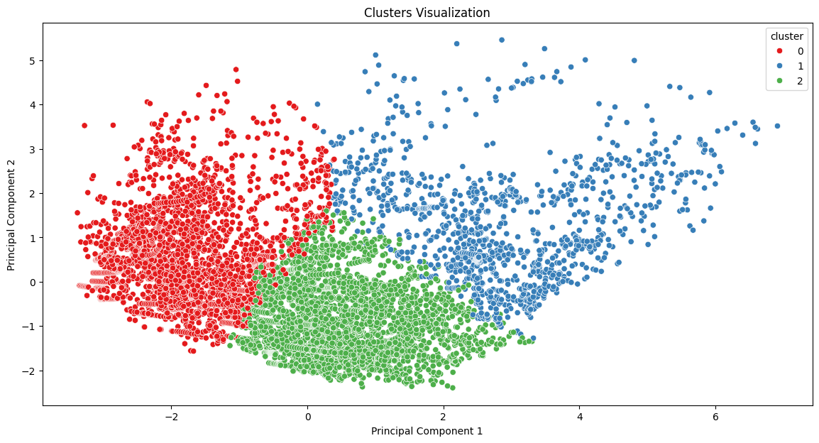

Slide 15

Conclusion & Future Work
Key Takeaways
Future Directions
Summary of findings and insights from the WDI dataset.
Explore advanced modeling techniques (e.g., neural networks).
Importance of data preprocessing and analysis.
Investigate model interpretability and causal relationships.
Assess impact of policy changes on development indicators.

Slide 16
Have any Question?
Thank you!

